Slide 1
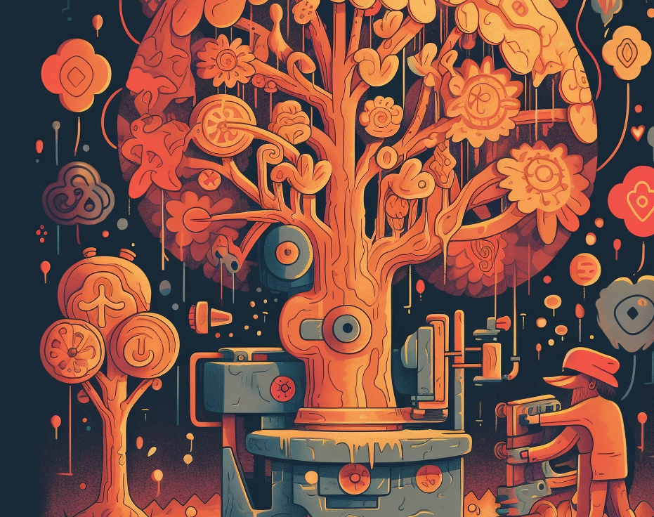
Psychedelic Trip Report Generator
A Flatiron Phase 5 Project by Jordan Loewen-Colón

Slide 2

Today’s Agenda
Business Problem
Goals
Data
Methods
Results

Slide 3
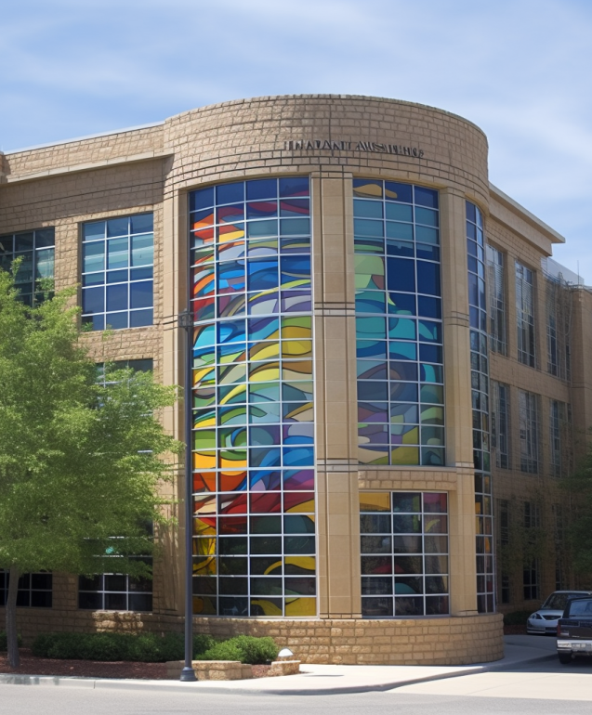
The Problem
The (fictional) MindSpectrum Research Institute, is deeply engaged in groundbreaking work involving the clinical trials of psychedelic-assisted therapies. These trials seek to gauge the safety and effectiveness of various psychedelic substances, including psilocybin, MDMA, LSD, Ketamine, and Cannabis.

Slide 4
Primary Goals
Develop
a text generator model
Aim
Produce human-like trip reports
Focus
on minimizing false positives and realistic sounding language.

Slide 5
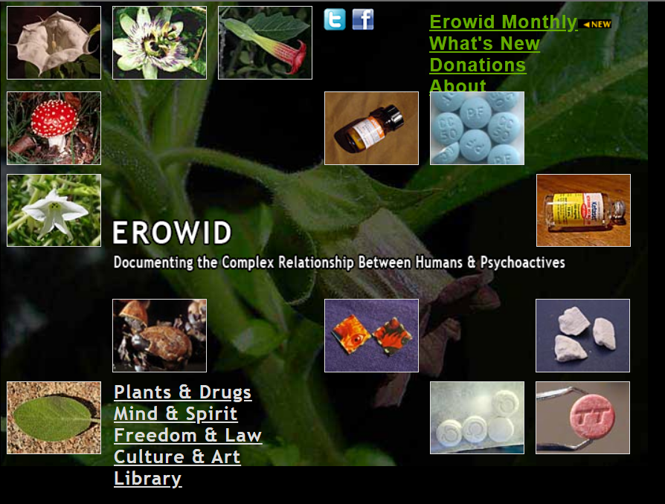
The Data
The dataset has 70k+ entries
The ‘reports’ vary from 3 to 32k words.
Other data points include:
Drug (11728 unique entries)
Dosage
Delivery
Weight
Year

Slide 6
Methods
Unsupervised Learning To Discover Patterns
Multiclassification for drug prediction
Large Language Model to help verify text outpu
GPT-2 for Text Generation

Slide 7
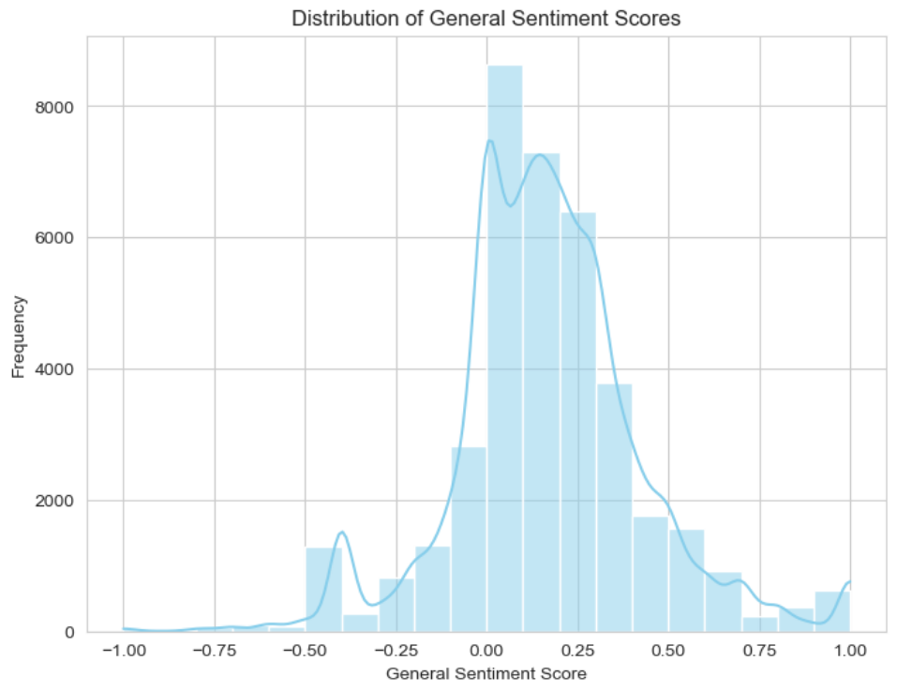
Each review was given a “sentiment’ score between -1 and 1
Higher scores means they used language that indicated more positivity
The average sentiment score falls between 0 and .25, which is favorable!

Slide 8
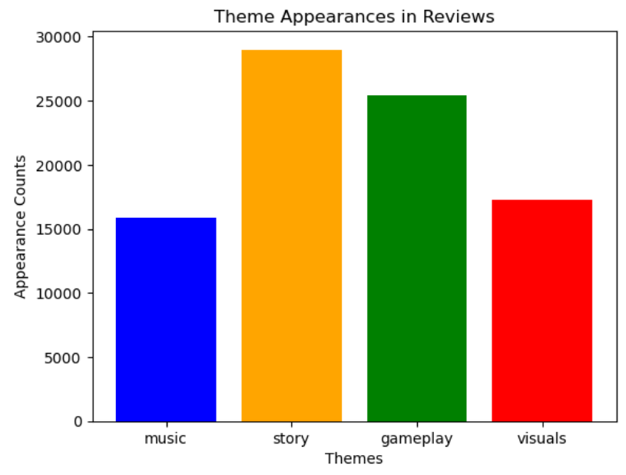
Counts of how many times players referenced a key word from a list of themes and synonyms.
Players were most likely to reference the story when writing reviews.
Generally, story references were rated more positively.

Slide 9
TOP 5 BIGRAMS BY THEME
Music | Story | Gameplay | Visuals
Sound, track - 10 | Side, quest - 9 | Attack, pattern -13 | Late, party - 9
Instead, audio - 12 | Question, asked - 13 | Power, ups - 8 | Add, cart - 7
Audio, eargasm - 12 | Family, drama - 11 | El, combate - 9 | Vibrant, color - 12
Musical, score - 12 | Extended, family - 14 | Power, creep - 10 | Color, palette -12
Mass, effect - 10 | Answer, question -14 | Micro, transaction - 16 | Farewell, earthly -15

Slide 10
Review Sentiment Analyzer
Review Length: 95
Review: go one best game time . 10/10 everything : story , gameplay , difficulty , art , voice acting .
Theme Words and Polarity
Music: voice acting, 0.548
Story: story, 0.525
Gameplay: gameplay, 0.500
Visuals: art, 0.594

Slide 11
Conclusions
reviews expressed positive sentiment within the range of 0 to 0.25.
In reviewers emphasized story.
Reviewers may have limited vocabulary when describing their appreciation for the 'music' and 'visuals.'

Slide 12
Recommendations
Focus on the strong storytelling elements.
Help players express positive impressions of 'music' and 'visuals' by providing in-game prompts or specific key words or phrases.

Slide 13
Concerns & Interest
Computational efficiency limited pattern recognition
Findings indicate there is value in further study!

Slide 14
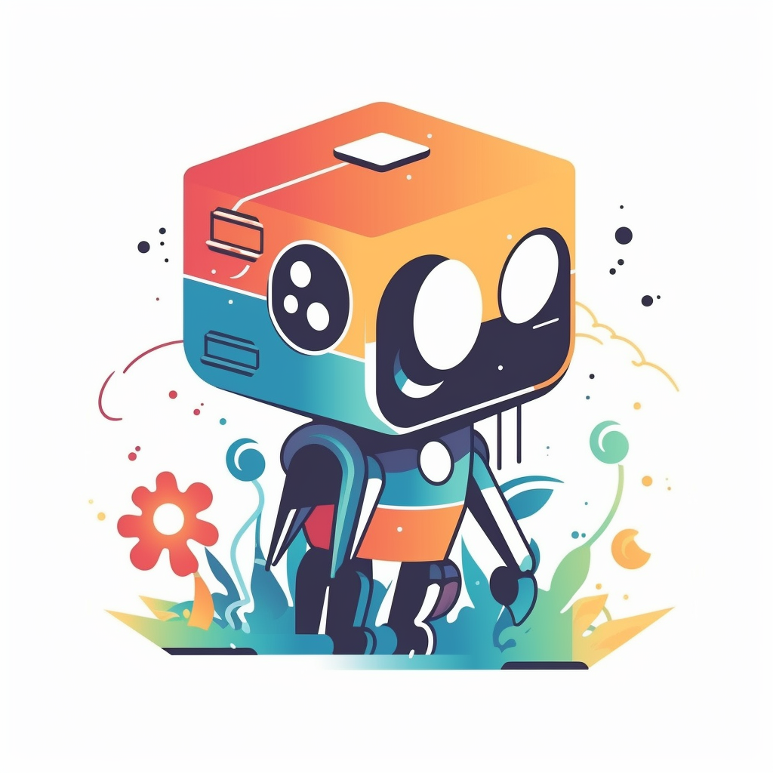
Thank You
Jordan Loewen-Colón
jbloewen@syr.edu

